Slide 1
SALARY PREDICTION OF
DATA PROFESSIONS

Slide 2
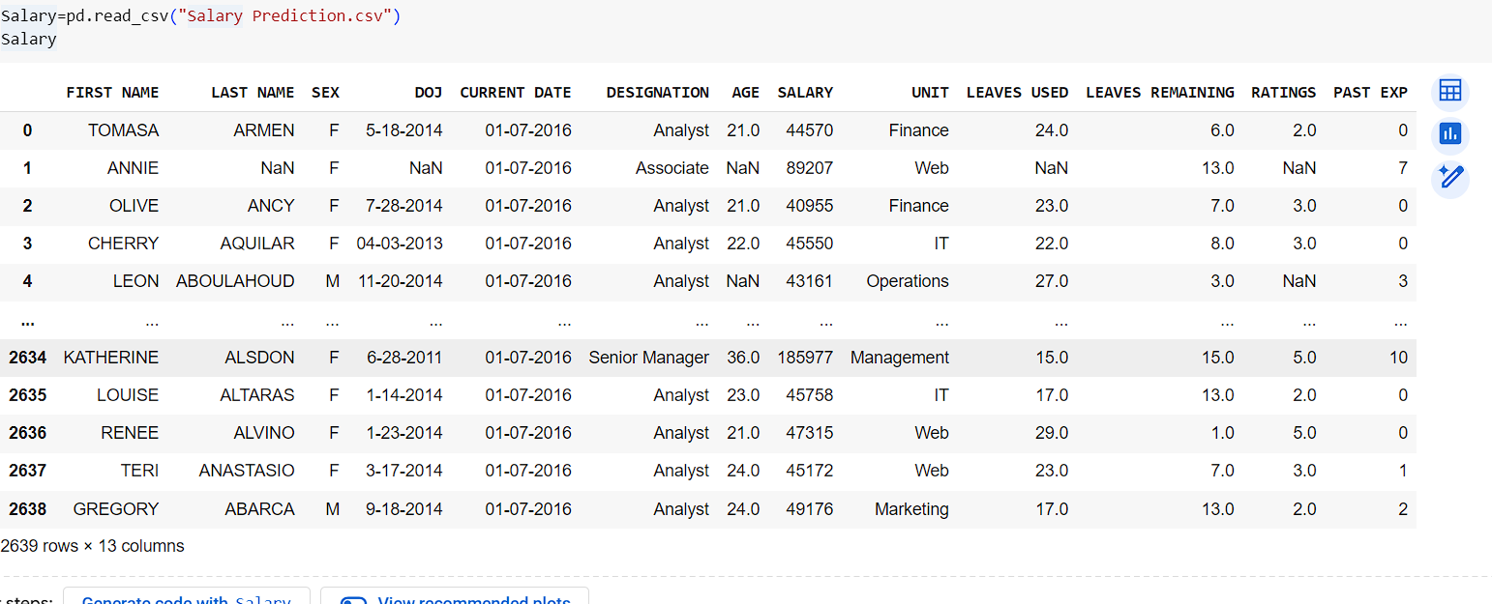
IMPORT REQURIED LIBRARIES
Load and read the dataset

Slide 3
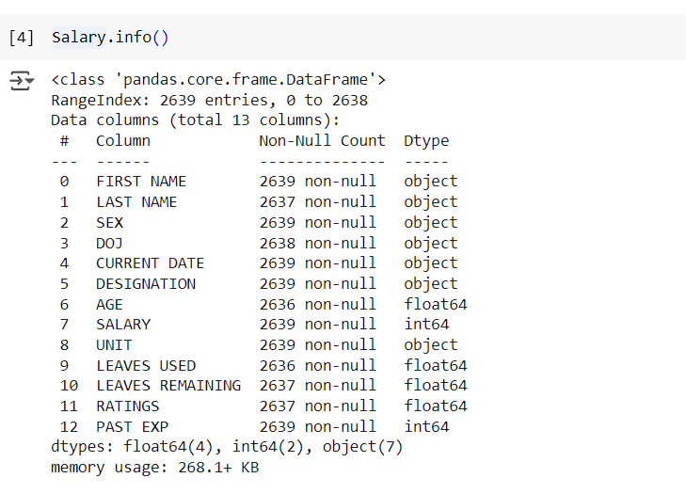
Salary.info()
Information about all the columns in the dataset

Slide 4
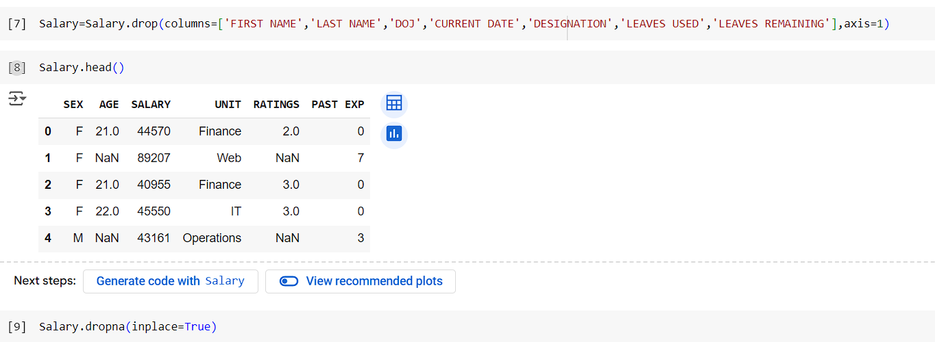
Data preprocessing :
Handling the missing values in the data set
Drop the null value

Slide 5
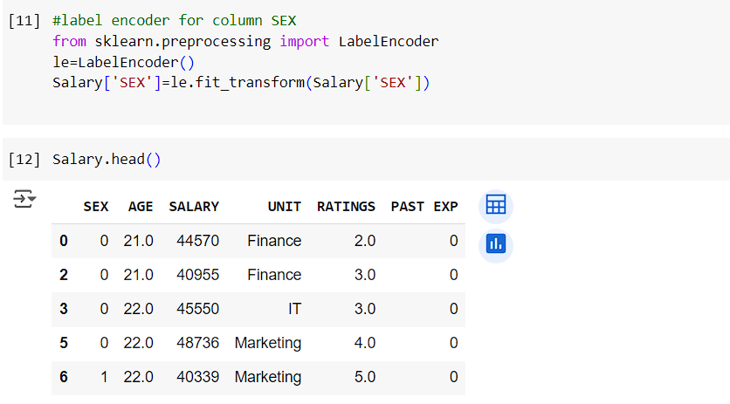
Label encoding for the column SEX

Slide 6
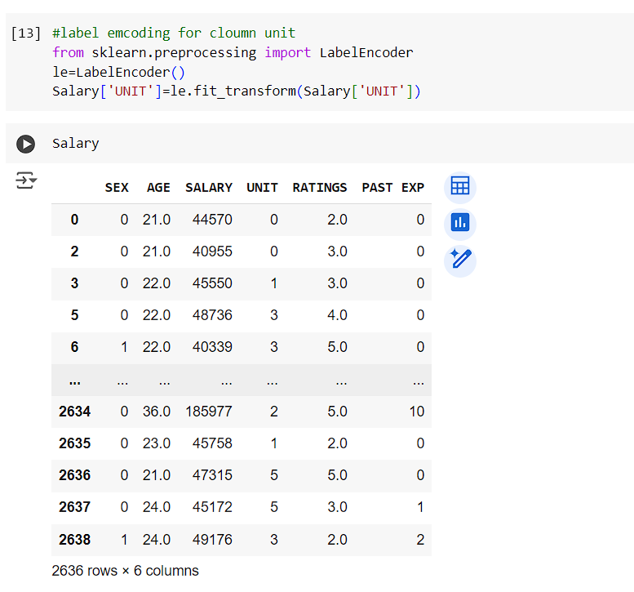
Label encoding for the column UNIT

Slide 7
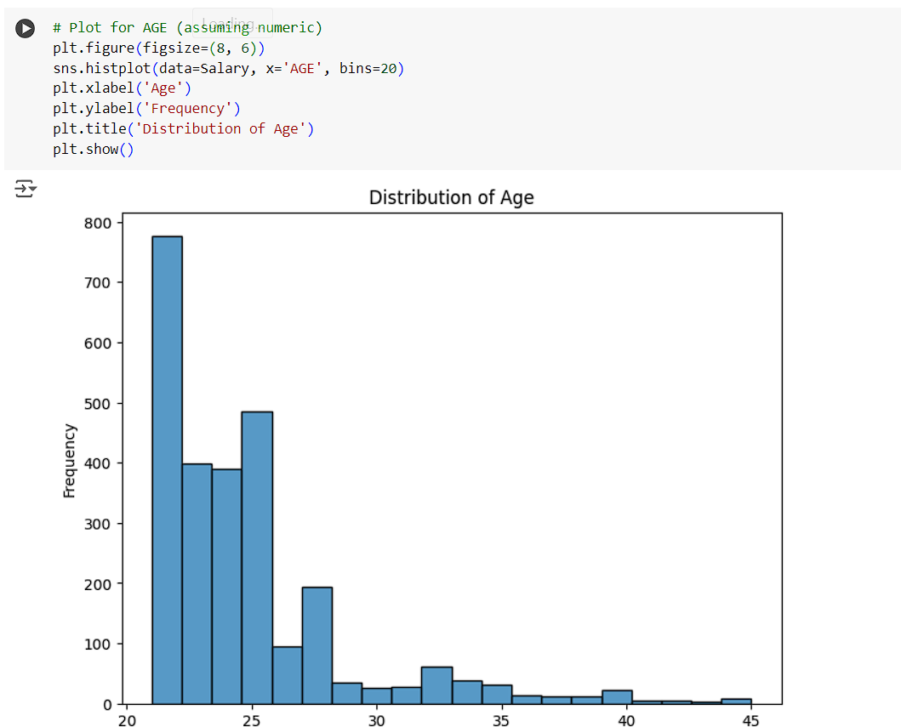
Data plot for the Age

Slide 8
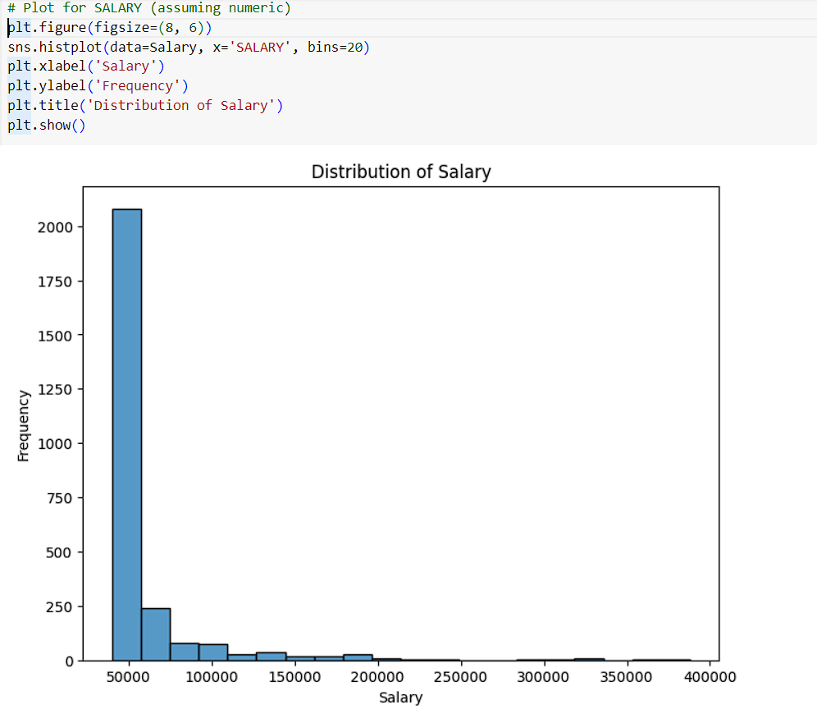
Data plot for Salary

Slide 9
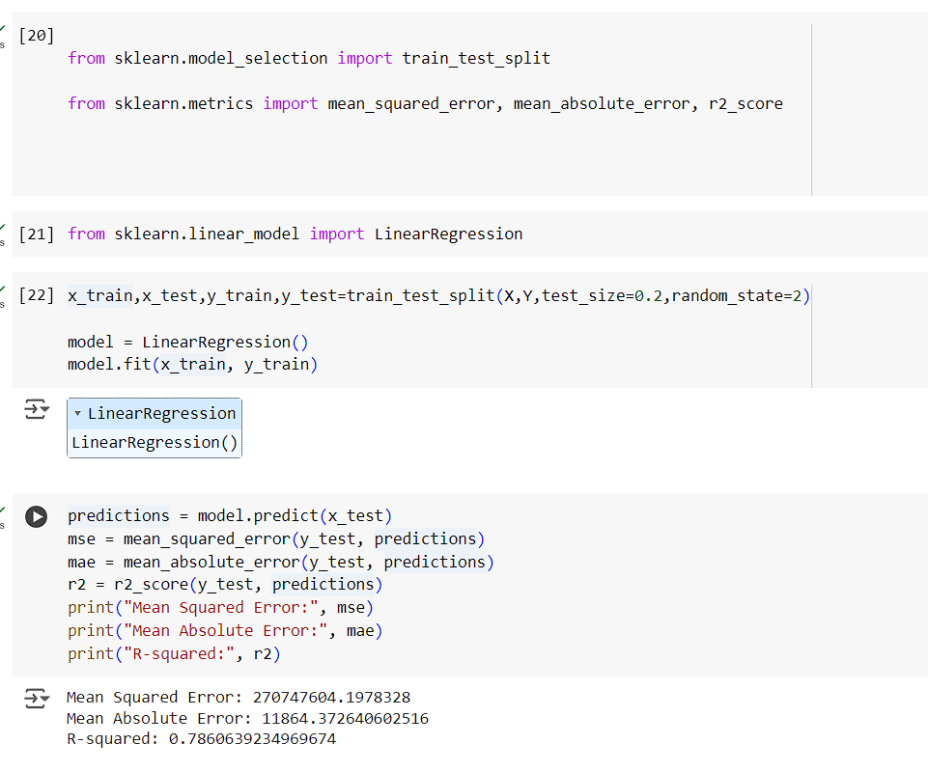
Import the required libraries for the Linear Regression and Predict the model

Slide 10
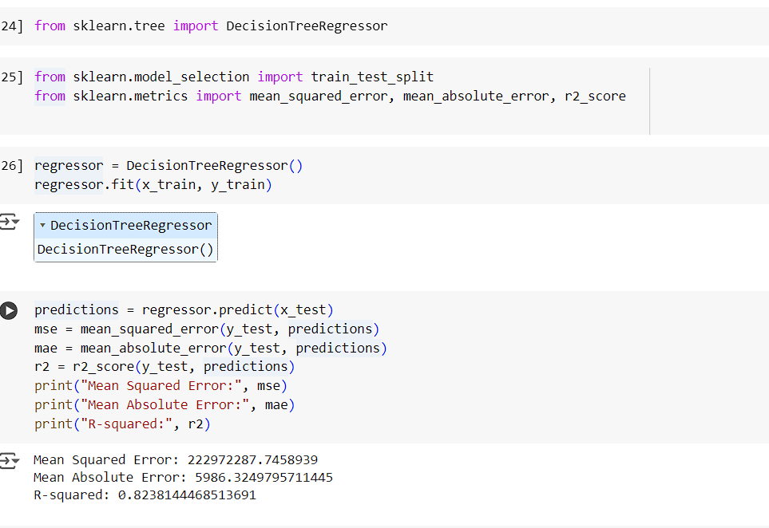
Import the required libraries for Decision tree and Predict the model

Slide 11
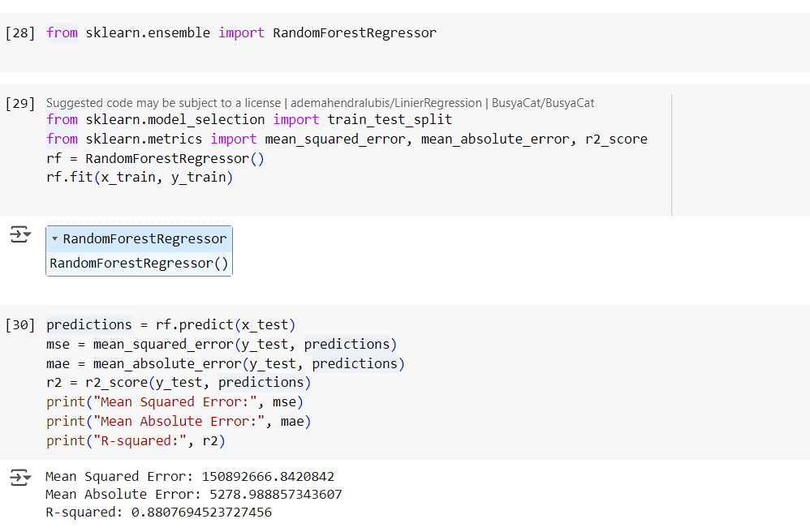
Import the Requried libraries for RandomForestRegressor and Predict the model

Slide 12
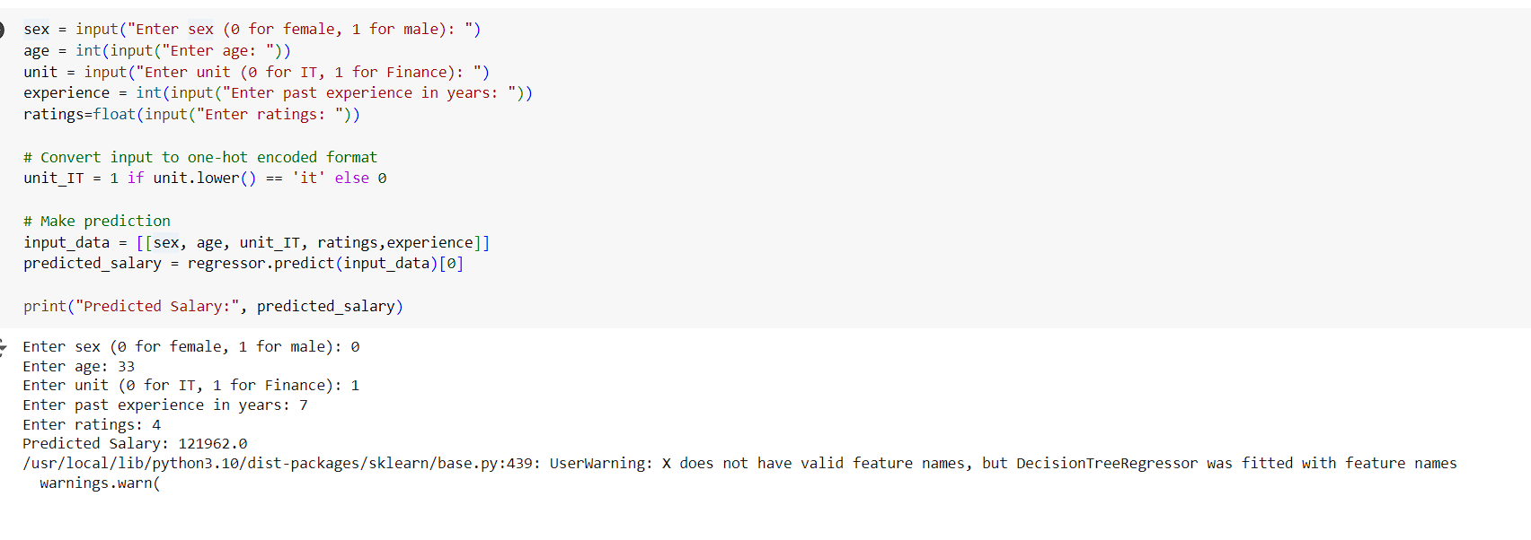
Predict the SALARY by the SEX,AGE,UNIT,RATINGS and PAST EXPERIENCES

Slide 13
THANK YOU

